Slide 1
MRL-SPL TDP
TDP 2013

Slide 2
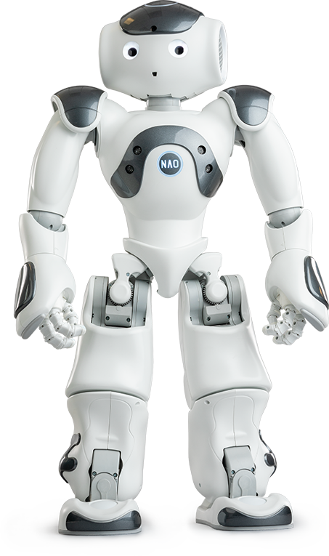
Introduction
MRL-SPL TDP 2013
MRL Participate in RoboCup since 2002
MRL-SPL Participate in RoboCup from 2012 to 2017

Slide 3
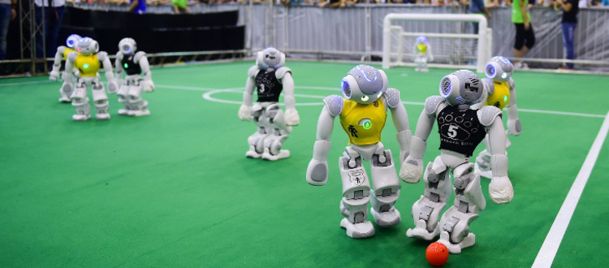
Standard Platform League
MRL-SPL TDP 2013
Robot Play Soccer against each other on teams of 5.
Team only contribute on the Robot Software.

Slide 4
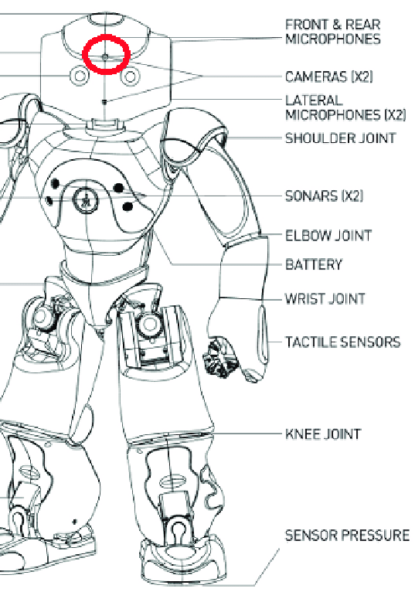
Robot Architecture
MRL-SPL TDP 2013
Runs Linux OS
Intel Atom CPU
No-GPU
2x Camera
21 DOF Joint

Slide 5
Contents of this presentation
MRL-SPL TDP 2013
Software Architecture
Perception
Localization and Modeling
Behavior Control
Motion Control

Slide 6
Software Architecture
MRL-SPL TDP 2013
Blackboard Structure.
Modules:
Motion
Communication
Cognition
Perception
Modeling
Behavior
Black Board
Motion
Perception
Behavior

Slide 7
Perception
MRL-SPL TDP 2013
Simultaneous Image Acquisition
Camera and Torso Calibration
Robot Detection
Color Calibration

Slide 8
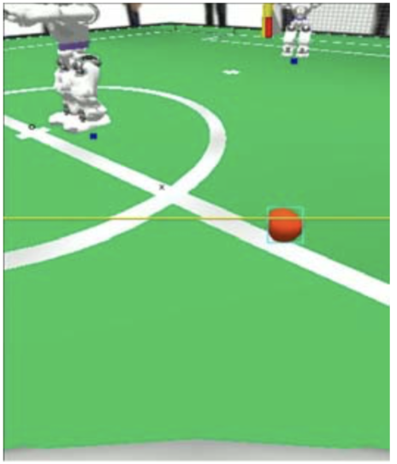
Simultaneous Image Acquisition
MRL-SPL TDP 2013
Previously Each image processed separately. (Processing whole world each other frame)
Image Inconsistency

Slide 9
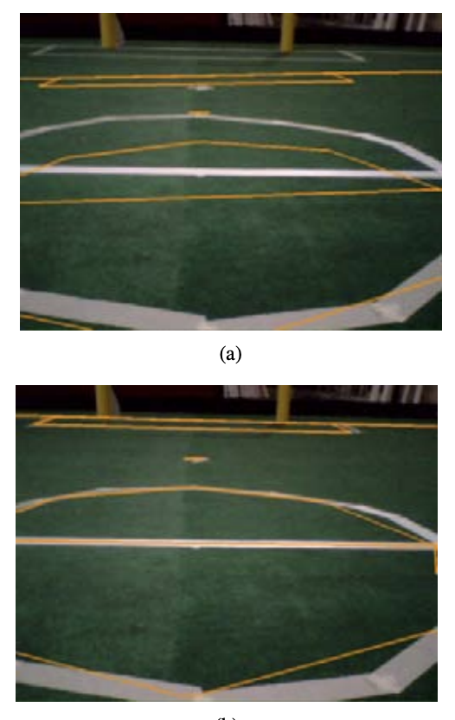
Camera and Torso Calibration
MRL-SPL TDP 2013
Displacement in Gyro Sensor and Cameras. (caused by collisions)
Project Field lines on the Image.
Calculate Errors using: Levenberg-Marquardt
Optimize Error using: Gauss-Newton optimization

Slide 10
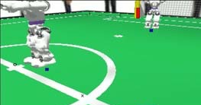
Robot Detection
MRL-SPL TDP 2013
Detect Robot Wrist Band
Rundown until reach the Field-Green
The white area around is Robot

Slide 11
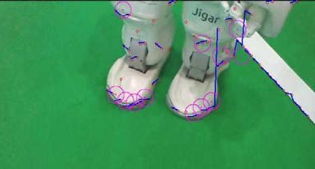
Robot Detection - On Lower Camera
MRL-SPL TDP 2013
No longer wrist band is visible
Fit Curve on the white pixels
If it is not a straight line, then it is a Robot

Slide 12
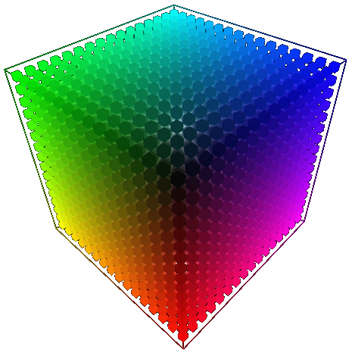
Color Calibration
MRL-SPL TDP 2013
Label each color prior to each game.
Use predefined color labels to detect objects.

Slide 13
Localization and Modeling
MRL-SPL TDP 2013
Localization
World Modeling
Coping with Symmetrical Environment

Slide 14
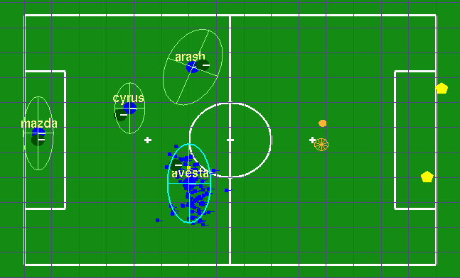
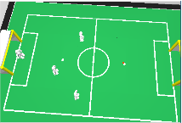
Localization
MRL-SPL TDP 2013
Reduce noise effect
Monte-Carlo Localization (Particle Filter)

Slide 15
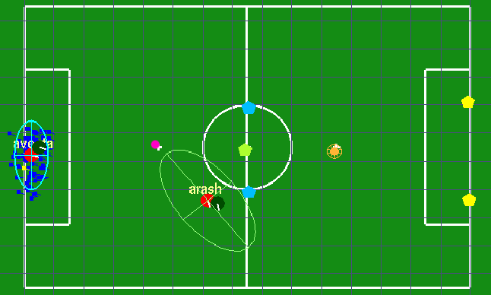
World Modeling
MRL-SPL TDP 2013
Model the object in order to track them.
Robot Pose-Correction Flag*
Role probability
Universal Ball

Slide 16
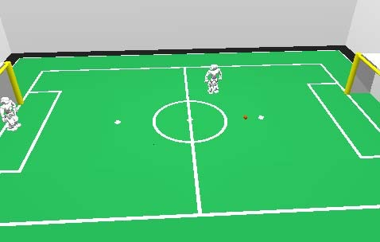
Coping with Symmetrical Environment
MRL-SPL TDP 2013
Goalie see the ball and report to other players.
Check the personal ball with the goalie report.

Slide 17
Behavior Control
MRL-SPL TDP 2013
Behavior Module Structure
Path Planning
Dynamic Head Motion

Slide 18
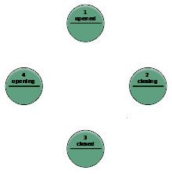
Behavior Module Structure
MRL-SPL TDP 2013
Finite State Machine
Control the robot actions based on World-Model Data.
Action Level:
High-Level (e.g. player role)
Mid-Level (e.g. Search for Ball)
Low-Level (e.g. Move forward 10step)

Slide 19
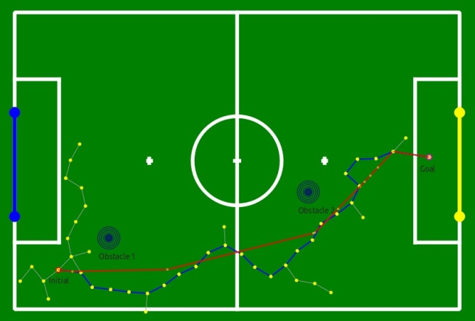
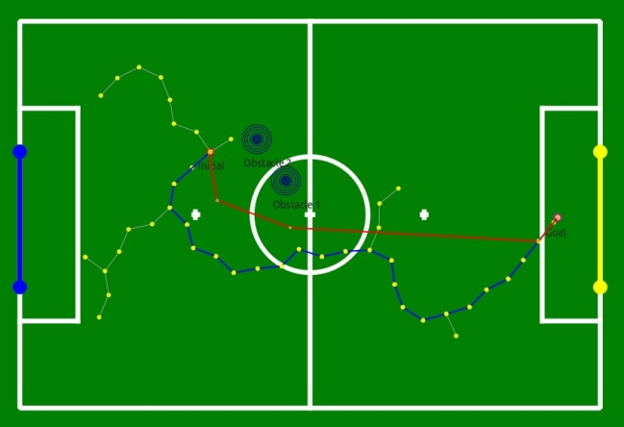
Path Planning
MRL-SPL TDP 2013
Using Rapid-Exploring Random Trees (RRT)
Find the optimal path to the target.

Slide 20
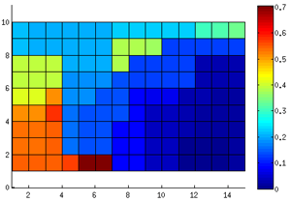
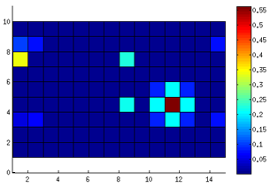
Dynamic Head Motion
MRL-SPL TDP 2013
Probability Grid on the Field
Look grid with highest information
Informative objects:
Landmarks (Goal-posts, Lines)
Ball
Obstacles

Slide 21
Motion Control
MRL-SPL TDP 2013
Walk Engine
Dynamic Kick Engine

Slide 22
Walk Engine
MRL-SPL TDP 2013
Inverted Pendulum
Pendulum

Slide 23
Walk Engine
MRL-SPL TDP 2013
Balancing on two foot is like inverted pendulum.
Center Of Mass (CoM) is the pendulum.

Slide 24
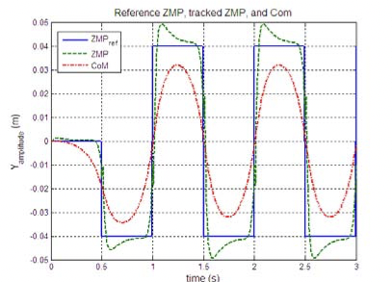
Walk Engine
MRL-SPL TDP 2013
Zero Moment Point (ZMP) is calculated via CoM
We control the robot in a way that ZMP follows the CoM
Control using: LIPM

Slide 25
Dynamic Kick Engine
MRL-SPL TDP 2013
Normally we use Special Action
Very dependent to the initial formation
Take a long time to get in position
Dynamic Kick Engine
Fast
Accurate
Controllable

Slide 26
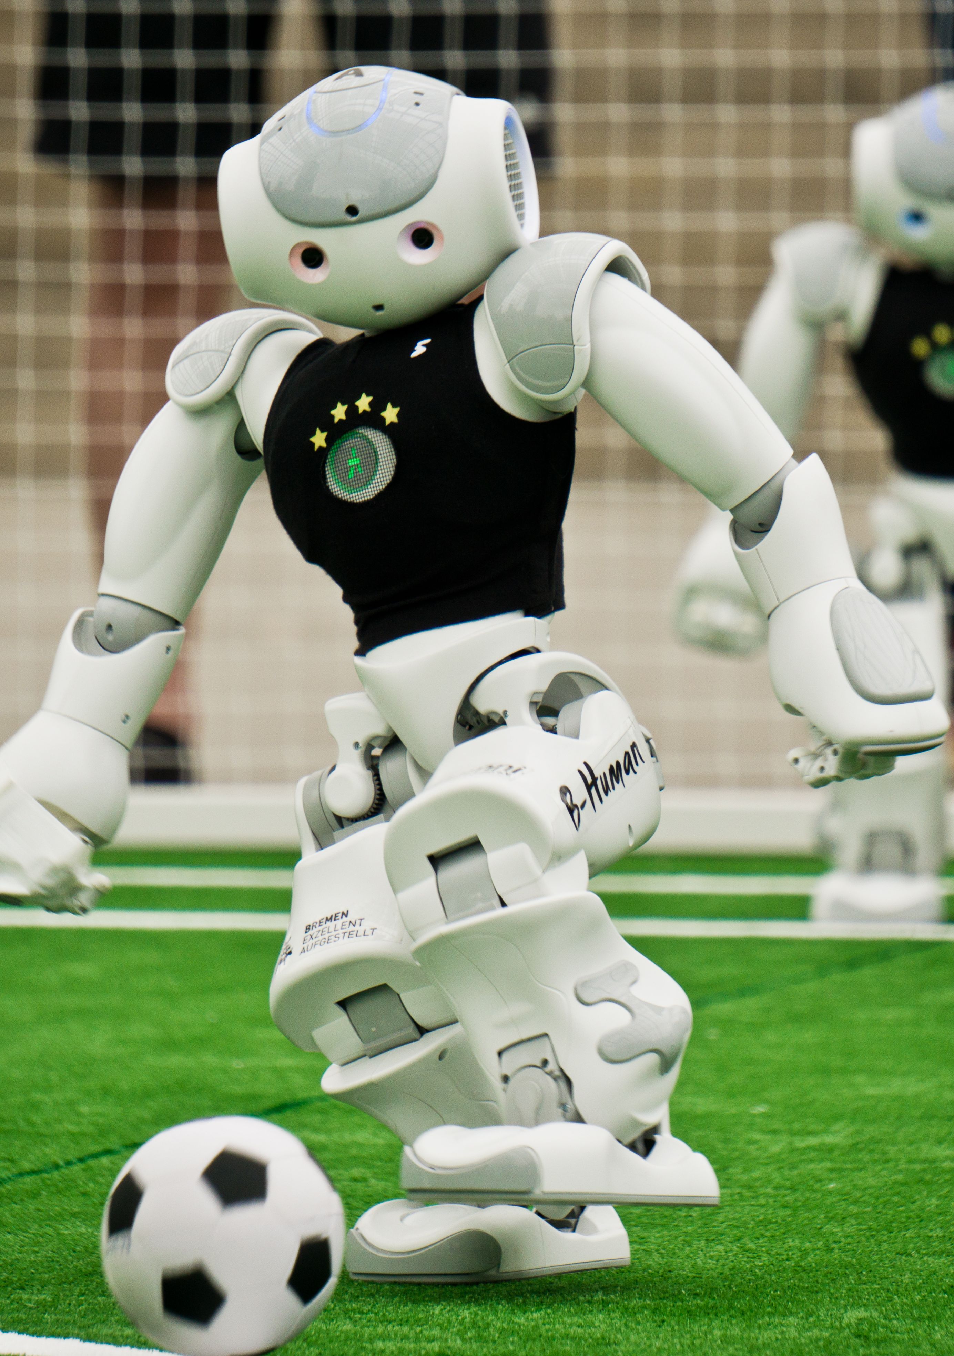
Future Works
MRL-SPL TDP 2013
Development of an unfailing multi agent planning to use role base selection with a range of procedures such as ad-hoc role selection and matrix cost
Enhancements of the available dynamic head motion to be adaptive with different world model data such as predicted universal ball and obstacle models
Improvements in the combined path planning practice which implements both global and relative positioning data in diverse maneuvers. Moreover, active strategy selection and planning during the game accompanied by rapid decision making

Slide 27
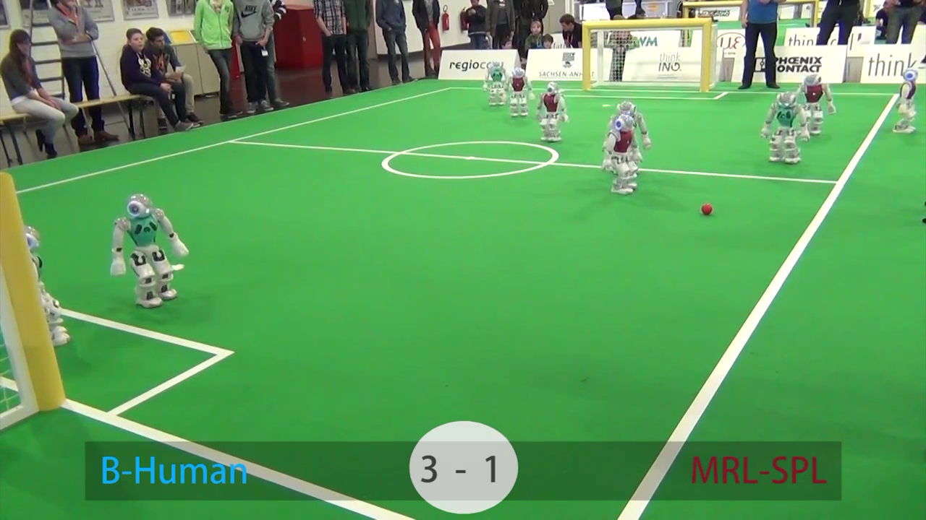
MRL-SPL Qualification Video - 2014

Slide 28
The End

